Slide 1
Analysis of COVID-19 Patients with Pre-Existing Conditions
Alex Bass, Connie Cui, Peumali Surani Withanage, Seth Galluzzi

Slide 2
Aim
The aim of this project is to gain an understanding of how pre-existing medical conditions impact COVID-19 patients in hospitals.
Rationale
We will accomplish this by comparing the mortality rates of patients with pre-existing conditions to the mortality rates of patients without pre-existing conditions.
We will then use our data to calculate the probability of survival for a new patient.

Slide 3
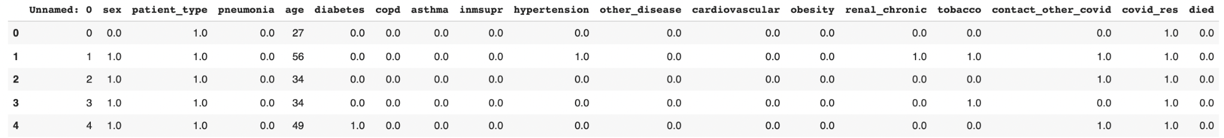
The Data
The data set we are exploring was released by the Mexican government and contains information on hospitalized COVID-19 patients.
The data includes variables such as age, sex, diabetes, pneumonia, and obesity.
Most of the data was categorical with 0 and 1 values.

Slide 4
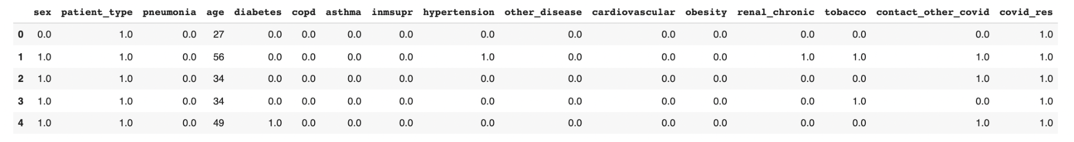
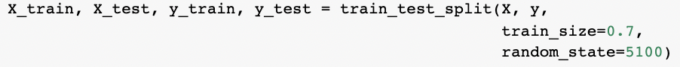
Data Cleaning
Though our data was relatively clean, we did complete some cleanup before creating visualizations. For example, we dropped an unnamed column from the data set.
We also split the data into training and test sets to test our analysis and run our data through machine learning classifiers to determine the best model to make our predictions.

Slide 5

Identifying Key Visualizations
We used histograms, bar charts, and proportions to interpret our data effectively.
Each of our visualizations was an opportunity to further our understanding of the data.

Slide 6
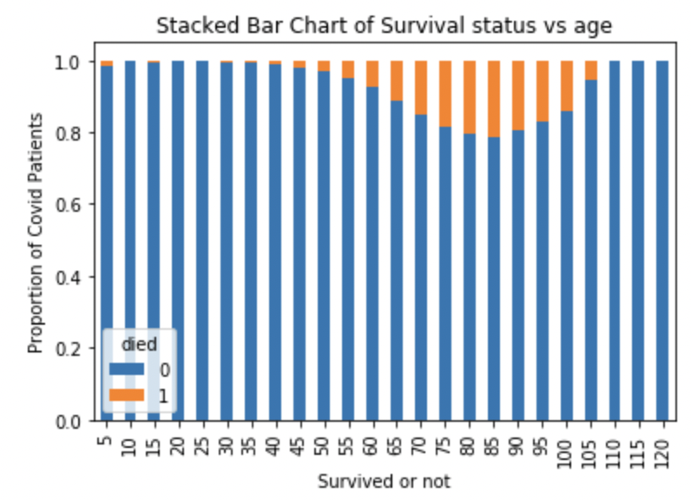
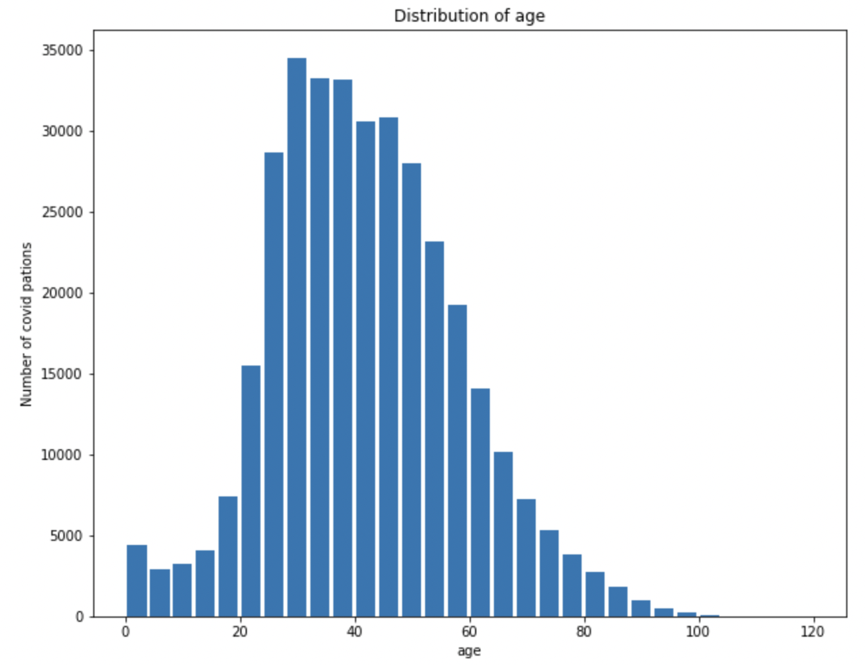
Identifying Key Visualizations

Slide 7
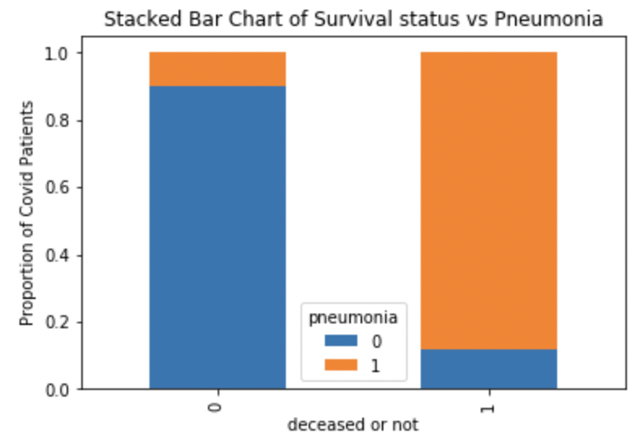
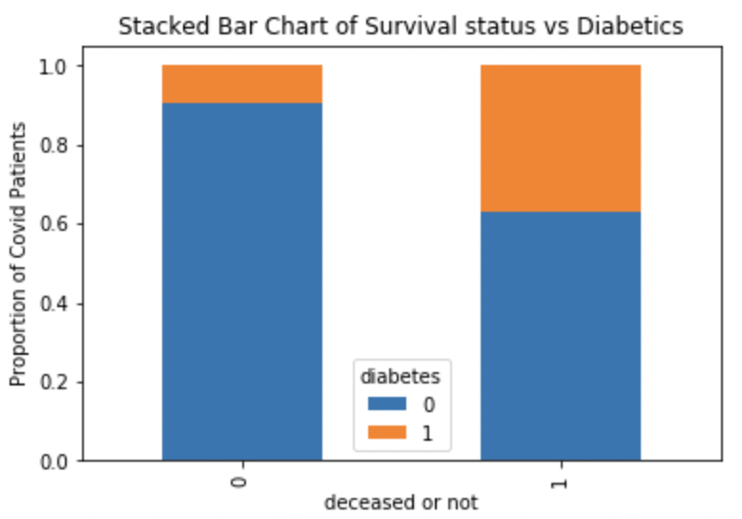
Identifying Key Visualizations

Slide 8
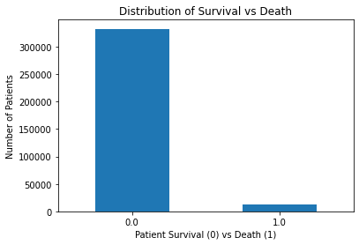
Knowledge from Visualizations
Fortunately, one major issue with our data was the large number of survivors!
To prevent Type II error, we created a balanced dataset with oversampling techniques.

Slide 9
Model Selection
We used machine learning to train three models with the original, unbalanced data and three models with balanced data that we created with oversampling.
Classifiers used:
Logistic Regression
Decision Tree
Random Forest

Slide 10
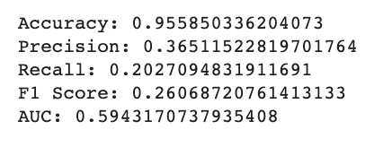
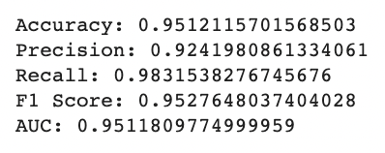
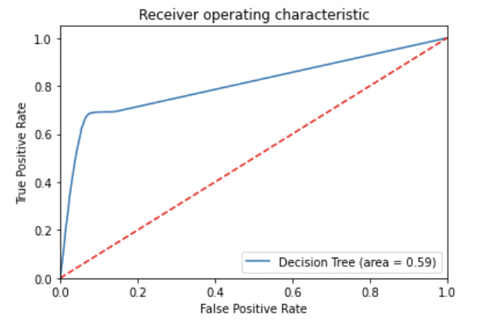
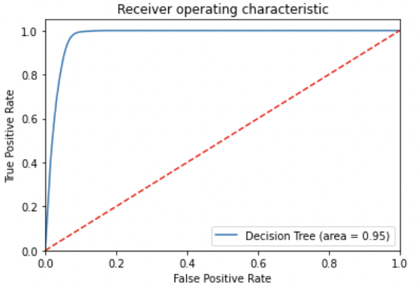
The Impact of Balancing Our Data

Slide 11
Model Selection Results
We used machine learning to train three models with the original, unbalanced data and three models with balanced data that we created with oversampling.
Original Dataset | Logistic Regression | Decision Tree | Random Forest
Accuracy | 0.9613 | 0.9559 | 0.9569
F1 Score | 0.2424 | 0.2607 | 0.2769
*F1 Score = weighted average of Precision and Recall (takes both false positives and false negatives into account)
Balanced Dataset | Logistic Regression | Decision Tree | Random Forest
Accuracy | 0.9148 | 0.9513 | 0.9520
F1 Score | 0.9147 | 0.9513 | 0.9519
Notes:
Compare accuracy and f1 for all 6?

Slide 12
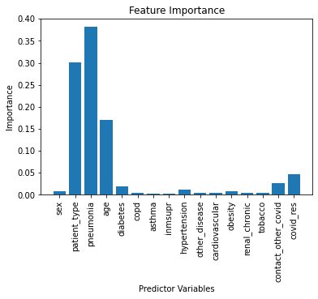
Identifying Our Best Predictors
Using the optimal random forest classifier trained with our balanced data set, we determined patient type (inpatient vs outpatient), pneumonia, and age were the most important predictors.
Same EDA visualization from slide7

Slide 13
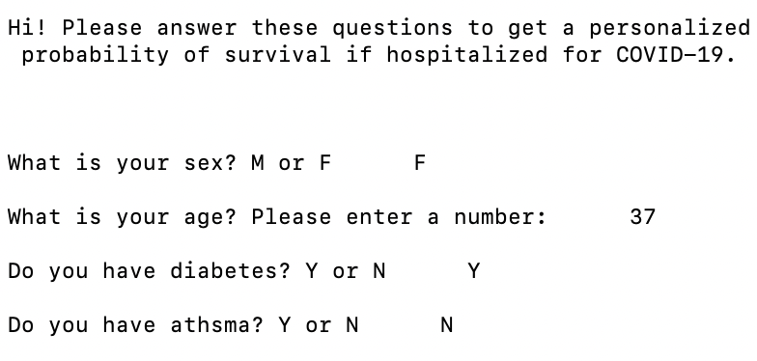
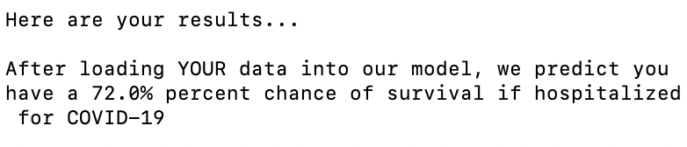
Applying our Knowledge
To inform others of the impact pre-existing conditions have on COVID-19 patients, we chose to give the user the ability to explore different conditions and how they impact survival rates with a Command Line Interface (CLI):
…….

Slide 14
Old Man Hackandcough vs. Young Woman Febreze
Old Man Hackandcough is a 79 year old male previously diagnosed with pneumonia. He was admitted into the hospital for further monitoring and treatment.
Based on our model, Old Man Hackandcough’s probability of survival is 65%
Young Woman Febreze is a 24 year old female with no pre-existing health conditions who had an appointment at the hospital for a medical screening.
Based on our model, Young Woman Febreze’s probability of survival is 100%.

Slide 15
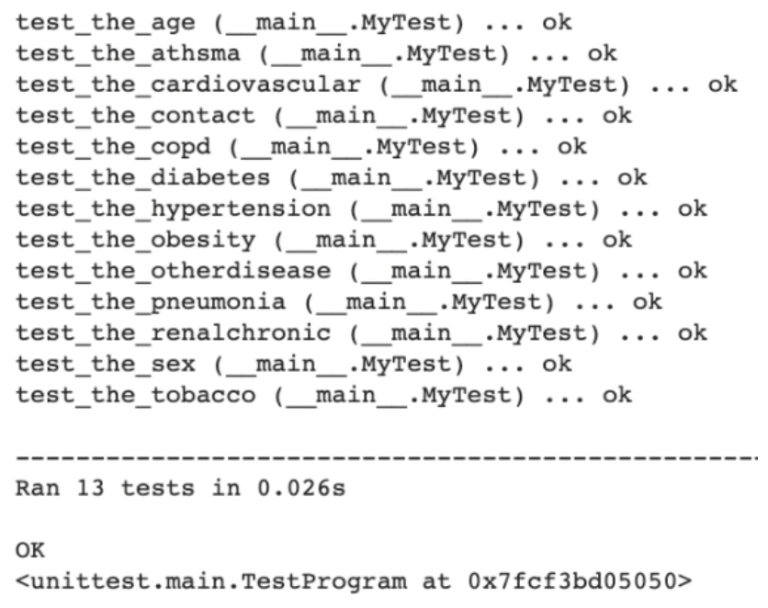
Testing User Input
We used unit testing to ensure the user’s data would be properly documented.

Slide 16
Summary
The aim of this project was to gain an understanding of how pre-existing conditions impact patients with COVID-19 in hospitals.
We set out to accomplish this by comparing mortality rates, exploring visualizations, and making predictions using a data set obtained from the Mexican government.
We learned that many pre-existing conditions impact COVID-19 patients.
Based on our model, we identified pneumonia, patient type, and age to be the most important when predicting the probability of survival.
We then conveyed our understanding effectively by allowing the user to input different pre-existing conditions to obtain the probability of survival.

